Slide 1
Software Engineering
UNIT-IV
B.Tech(CSE)-IV SEM
Dept of CSE

Slide 2

UNIT-IV: Coding and Testing: Programming principles and guidelines, incrementally developing code, Testing concepts, testing process, Black-box testing, White-box testing.
Risk management: Reactive vs. Proactive Risk strategies, Software risks, Risk identification, Risk projection, Risk refinement, RMMM Plan
SRI VASAVI ENGINEERING COLLEGE
PEDATADEPALLI, TADEPALLIGUDEM-534 101
Department of Computer Science & Engineering
Academic Year:2021-22
Course Title: Software Engineering
Course Code: V20CST07
Semester:IV
Syllabus

Slide 3
Part-1
Coding
Dept of CSE

Slide 4
Programming Principles and Guidelines:
The coding is the process of transforming the design of a system into a computer language format.
This coding phase of software development is concerned with software translating design specification into the source code.
Coding is done by the coder or programmers who are independent people than the designer.
The main goal of a programmer is to
  write readable code with few bugs in it.
  write code quickly and quality code
  To translate the design of system into a computer language format.
  To reduce the cost of later phases ( Testing and maintenance)
In this section, we will discuss some concepts and practices that can help a programmer write higher-quality code that is also easier to understand.
Dept of CSE

Slide 5
Structured Programming:
Structured programming started in the year 1970’s primarily against the use of unconditional goto ‘s statements.
In early programming languages, like Fortran and various low level machine languages, the goto statement allowed the computer to deviate from the sequential execution of the program instructions. The goto statement was recognized to be a very powerful construction.
However, the increasingly complex code that resulted from goto statements became harder and harder to maintain. Dijkstra, in 1966, was one of the first persons to recognize that this run away complexity of programs was due to the overuse of the goto statement.
It was determined shortly thereafter, that the goto statement is not needed at all. Dijkstra showed that any program construction that are using with goto statements could be created more simply with the sequence, repetition and decision constructions.This was the birth of the discipline of Structured Programming.
Dept of CSE

Slide 6
The goal of structured programming is to simplify the program so it is easier to discuss about programs.
Structured programming practice helps programmers to develop programs that are simple, easier to understand and easier for verification .
  If a program contains thousands of instructions and an error occurs, it is difficult to locate that error throughout the program; however, if our code is in a structured manner, we can easily detect the error and then go to that location to correct it to save a significant amount of time.
Dept of CSE

Slide 7
The size of the software grows as the lines of code multiply during the coding process, as we all know. Gradually, recalling the program's flow becomes nearly impossible. Sharing, debugging, and modifying software becomes extremely difficult if one forgets how software and its underlying programmes, files, and procedures are built. The solution to this problem is structured programming. It encourages programmers to use subroutines and loops rather than simple jumps in the code, which results in greater clarity and efficiency. It also aids programmers in reducing coding time and organizing their code properly.
The languages that support Structured programming approach are:
  C
  C++
  Java
Dept of CSE

Slide 8
Most commonly used Structured programming elements are:
  Sequence Statements
  Selection Statements
  Iteration Statements
  Here we discuss how these elements should be.
Dept of CSE

Slide 9
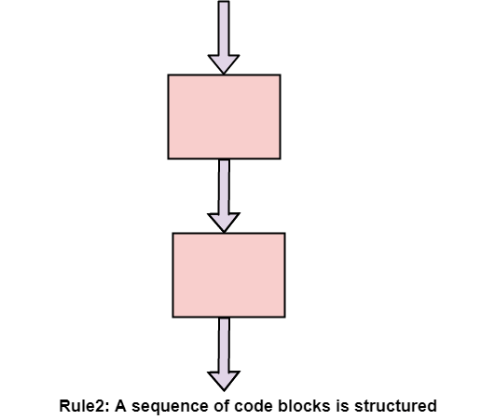
  Sequence Statements
  A sequence of blocks is correct if the exit conditions of each block match the entry conditions of the following block. Execution enters each block at the block's entry point and leaves through the block's exit point. The whole series can be regarded as a single block, with an entry point and an exit point.
Dept of CSE

Slide 10
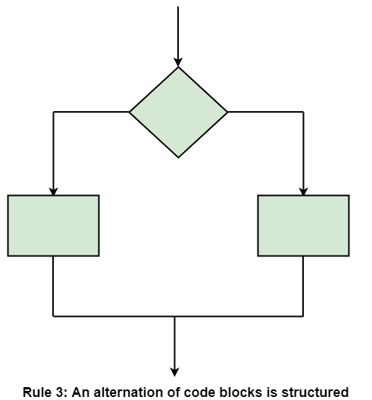
  Selection Statements
  If-then-else is frequently called Selection (because there are alternative options). In structured programming, each choice is a code block. If Selection is organized as in the flowchart at right, then there is one entry point (at the top) and one exit point (at the bottom). The structure should be coded so that if the entry conditions are fulfilled, then the exit conditions are satisfied (just like a code block).
Dept of CSE

Slide 11
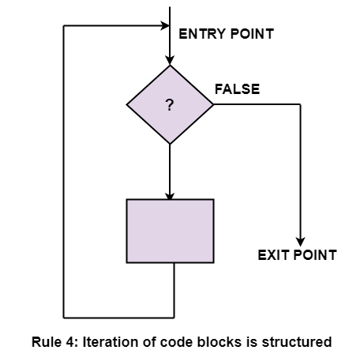
  Iteration Statements
  Iteration (while-loop) is organized as at right. It also has one entry point and one exit point. The entry point has conditions that must be satisfied, and the exit point has requirements that will be fulfilled. There are no jumps into the form from external points of the code.
Dept of CSE

Slide 12
2) Information Hiding:
Software solutions always contain data structures that hold information.
Programs work on these Data Structures to perform the functions they want as per the solution required.
In general, only certain operations are performed on some information of the DS. That is, a piece of information in the problem domain is used only in a limited number of ways in the problem domain.
  For example, a ledger in an accountant’s office has some very defined uses: debit, credit, check the current balance, etc. An operation on debits is performed information of debits is used not the information of credits.
Dept of CSE

Slide 13
Information hiding – the information should be hidden; only operations on it should be exposed.
I.e. data structures are hidden behind the access functions, which can be used by programs.
Many of the older languages, like Pascal, C, and FORTRAN, do not provide mechanisms to support data abstraction.
Information hiding can reduce the coupling between modules and make the system more maintainable.
This practice is a key foundation of Object Oriented languages and is also widely used today.
Dept of CSE

Slide 14
3) Some Programming Practices:
The concepts discussed above can help in writing simple and clear code with few bugs.
There are many programming practices that can also help toward that objective.
We discuss here a few rules that have been found to make code easier to read as well as avoid some of the errors.
Control Constructs: As discussed earlier, it is desirable that as much as possible single-entry, single-exit constructs be used. It is also desirable to use a few standard control constructs rather than using a wide variety of constructs, just because they are available in the language.
Dept of CSE

Slide 15
Gotos: Gotos should be used in less number and in a disciplined manner. Only when the alternative to using gotos is more complex then only gotos should be used.
Information Hiding: As discussed earlier, information hiding should be supported where possible. Only the access functions for the data structures should be made visible while hiding the data structure behind these functions.
User-Defined Types: Modern languages allow users to define types like the enumerated type. When such facilities are available, they should be exploited where applicable. For example, when working with dates, a type can be defined for the day of the week.
Dept of CSE

Slide 16
Nesting: If nesting of if-then-else constructs becomes too deep, then the logic become harder to understand. Where possible, deep nesting should be avoided. For example, consider the following construct of nested if-then-elses:
  if C1 then S1
  else if C2 then S2
  else if C3 then S3
  else if C4 then S4;
this structure can be converted into the following structure:
  if C1 then S1;
  if C2 then S2;
  if C3 then S3;
  if C4 then S4;
This sequence of statements will produce the same result as the earlier sequence
Dept of CSE

Slide 17
Module Size: We discussed this issue during system design. A programmer should carefully examine any module with too many statements (say more than 100). Large modules often will not be functionally cohesive. We should follow the guiding principle of cohesion and coupling.
Module Interface: A module with a complex interface should be carefully examined. As a rule of thumb, any module whose interface has more than five parameters should be carefully examined and broken into multiple modules with a simpler interface if possible.
Side Effects: When a module is invoked, it sometimes has side effects of modifying the program state beyond the modification of parameters listed in the module interface definition, for example, modifying global variables. Such side effects should be avoided where possible, and if a module has side effects, they should be properly documented.
Dept of CSE

Slide 18
Robustness: A program is robust if it does something planned even for exceptional conditions. A program might encounter exceptional conditions in such forms as incorrect input, the incorrect value of some variable, and overflow. If such situations do arise, the program should not just “crash” or “core dump”; it should produce some meaningful message and exit gracefully.
Switch Case with Default: If there is no default case in a “switch” statement, the behavior can be unpredictable if that case arises at some point of time which was not predictable at development stage. Such a practice can result in a bug like NULL dereference, memory leak, as well as other types of serious bugs. It is a good practice to always include a default case.
Dept of CSE

Slide 19
Empty Catch Block: An exception is caught, but if there is no action, it may represent a scenario where some of the operations to be done are not performed. Whenever exceptions are caught, it is a good practice to take some default action, even if it is just printing an error message.
try {
FileInputStream fis = new
FileInputStream (" InputFile ");
}
catch ( IOException ioe) { } // not a good practice
Dept of CSE

Slide 20
Empty if, while Statement: A condition is checked but nothing is done based on the check. Such useless checks should be avoided.
if (x == 0) { } /* nothing is done after checking x */
else { }
Read Return to Be Checked: Often the return value from reads is not checked, assuming that the read returns the desired values. Sometimes the result from a read can be different from what is expected, and this can cause failures later.
For example, if read from scanf() is more than expected, then it may cause a buffer overflow.
Dept of CSE

Slide 21
Correlated Parameters: Often there is an implicit correlation between the parameters. For example, in the code segment given below, “length” represents the size of BUFFER. If the correlation does not hold, we can run into a serious problem like buffer overflow.
void ( char *src , int length , char destn [])
{
strcpy (destn , src ); /* Can cause buffer overflow
if length > MAX_SIZE */
}
Dept of CSE

Slide 22
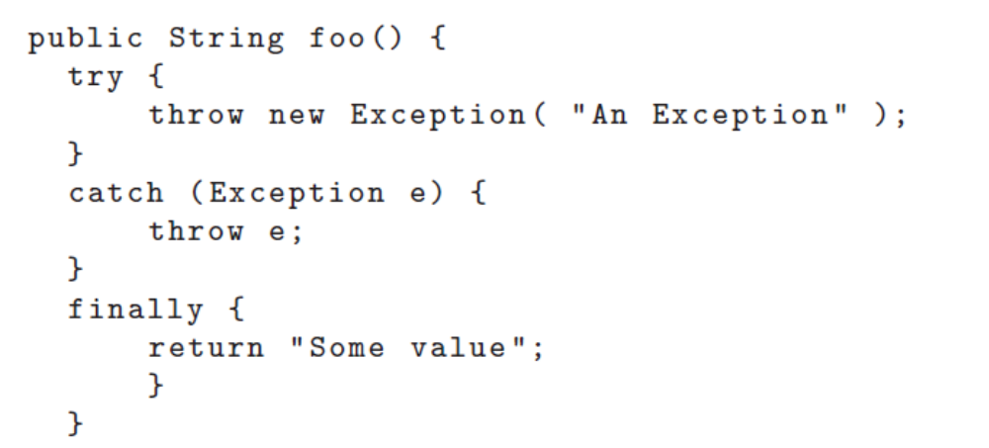
Return from Finally Block: One should not return from finally block, as it can create false beliefs. For example, consider the code
In this example, a value is returned both in exception and nonexception scenarios.
Hence, at the caller site, the user will not be able to distinguish between the two.
Dept of CSE

Slide 23
Trusted Data Sources: Counter checks should be made before accessing the input data, particularly if the input data is being provided by the user or is being obtained over the network.
  For example, while doing the string copy operation, we should check that the source string is null terminated, or that its size is as we expect.
  Similar is the case with some network data which may be sniffed and prone to some modifications or corruptions.
  To avoid problems due to these changes, we should put some checks, like parity checks, hashes, etc., to ensure the validity of the incoming data.
Dept of CSE

Slide 24
Give Importance to Exceptions: Most programmers tend to give less attention to the possible exceptional cases and tend to work with the main flow of events, control, and data.
  Though the main work is done in the main path, it is the exceptional paths that often cause software systems to fail.
  To make a software system more reliable, a programmer should consider all possibilities and write suitable exception handlers to prevent failures or loss when such situations occur.
Dept of CSE

Slide 25
4) Coding Standards
Programmers spend far more time reading code than writing code.
They read their own code as well as other programmers code
Readability is enhanced if some coding conventions are followed by all.
In general, coding standards provide guidelines for programmers regarding naming, file organization, statements and declarations, and layout and comments.
To give an idea of coding standards (often called conventions or style guidelines), we discuss some guidelines for Java, based on publicly available standards
Dept of CSE

Slide 26
Naming Conventions
Some of the standard naming conventions that are followed often are:
– Package names should be in lowercase (e.g., mypackage, edu.iitk.maths).
– Type names should be nouns and should start with uppercase (e.g., Day, DateOfBirth, EventHandler).
– Variable names should be nouns starting with lowercase (e.g., name, amount).
– Constant names should be all uppercase (e.g., PI, MAX ITERATIONS).
– Method names should be verbs starting with lowercase (e.g., getValue()).
– Private class variables should have the suffix (e.g., “private int value ”).
Dept of CSE

Slide 27
– Variables with a large scope should have long names; variables with a small scope can have short names; loop iterators should be named i, j, k, etc.
– The prefix is should be used for Boolean variables and methods to avoid confusion (e.g., isStatus should be used instead of status); negative boolean variable names (e.g., isNotCorrect) should be avoided.
– The term compute can be used for methods where something is being computed; the term find can be used where something is being looked up (e.g., computeMean(), findMin()).
– Exception classes should be suffixed with Exception (e.g., OutOfBoundException).
Dept of CSE

Slide 28
Files
  Source files should have .java extension
  Each file should contain one outer class and the name should be same as file
  Line length should be less than 80; if longer continue on another line…
Statements
  Vars should be initialized where declared in the smallest possible scope
  Declare related vars together; unrelated vars should be declared separately
  Class vars should never be declared public
  Loop vars should be initialized just before the loop
  Avoid using break and continue in loops
  Avoid executable stmts in conditionals
  Avoid using the do… while construct
Dept of CSE

Slide 29
Incrementally Developing Code:
The coding activity starts when some form of design has been available.
With the design, modules are assigned to developers for coding.
When modules are assigned to developers, they use some process for developing the code.
For coding, developers use different processes; we discuss some here.
1) Basic process: developers write the code for the currently assigned module, and when done, perform unit testing on it and fix the bugs. Then the code is listed in the project repository to make it available to others in the project.
A better process for coding, which is often followed by experienced developers, is to develop the code incrementally.
Dept of CSE

Slide 30
2) An Incremental Coding Process: First write the code for implementing some part of the functionality of the module.
This code is compiled and tested with some quick tests to check the code that has been written correctly or not.
When the code passes these tests, the developer proceeds to add further functionality to the code, which is then tested again.
This coding process is shown in following Figure
Dept of CSE

Slide 31
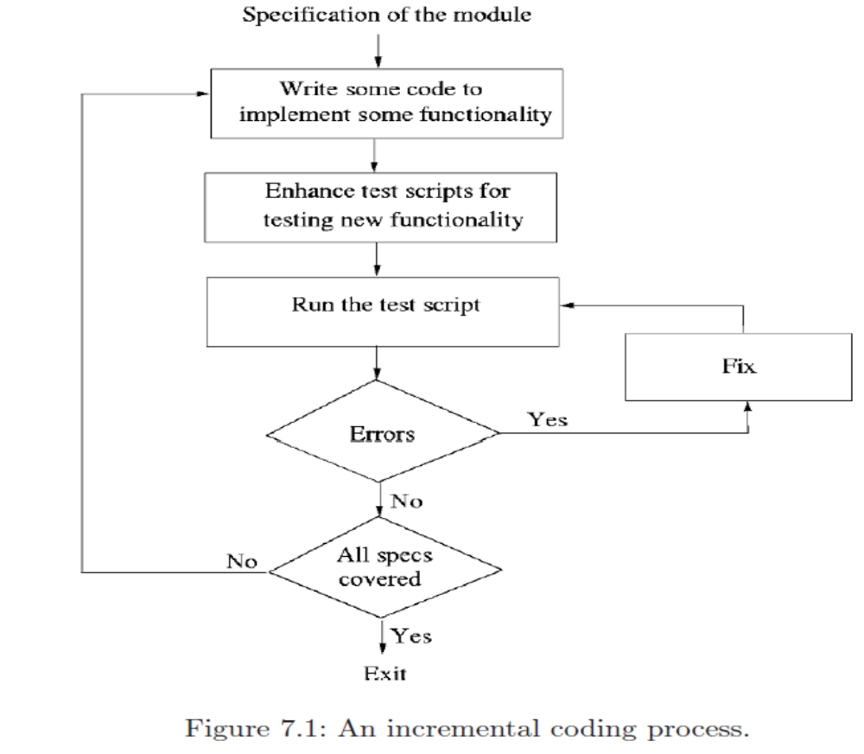
Dept of CSE

Slide 32
The basic advantage of developing code incrementally with testing being done after every round of coding is to facilitate debugging.
However, for following this process, it is essential that testing be done through test scripts that can be run easily.
With these test scripts, testing can be done as frequently as desired, and new test cases can be added easily.
These test scripts are also a tremendous aid when code is enhanced in the future—through the test scripts it can be quickly checked that the earlier functionality is still working.
Dept of CSE

Slide 33
3) Test-Driven Development:
In Test-Driven Development (TDD),first programmers writes the test scripts, and then writes the code to pass the tests, Instead of writing code and then developing test cases to check the code.
The whole process is done incrementally, with tests scripts are written based on the specifications and code being written to pass the tests.
The TDD process is shown in following Figure.
Dept of CSE

Slide 34

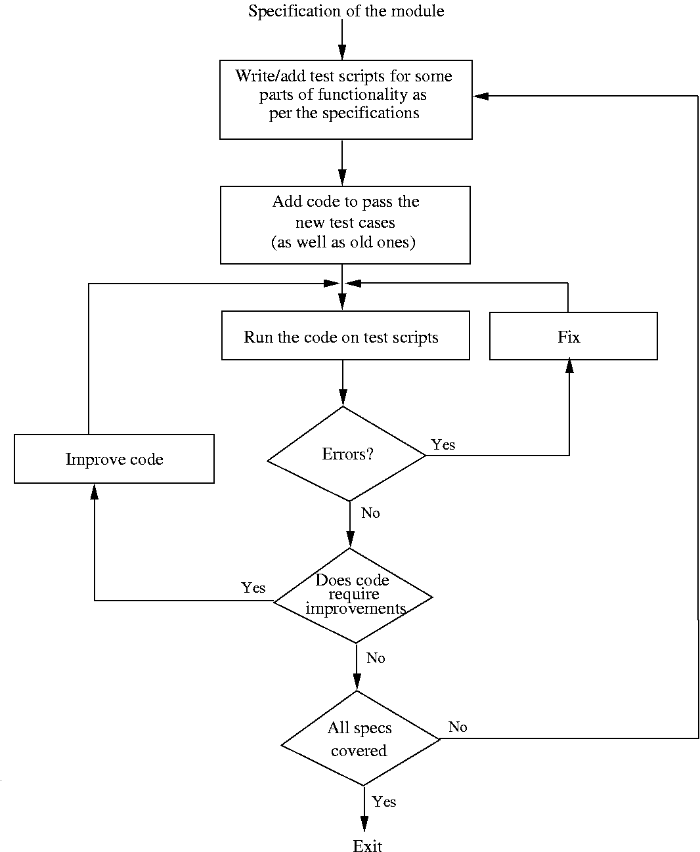
Dept of CSE

Slide 35
This writing of test cases before the code is written makes the development usage-driven.
Since test cases have been written first from the specifications, how the code is to be used gets the attention first. This helps ensure that the user interfaces are validated as specified in the design. This can help reduce interface errors.
Functionality prioritization happens in TDD i.e. first few tests are written for the main functionality. the test cases for lower-priority features or functionality will be developed later. Consequently, code for high-priority features will be developed first and lower-priority items will be developed later. This has the benefit that higher-priority items get done first, but has the drawback that for some of the lower-priority features, test cases are not written.
Has possibility that special cases for which test cases are not possible get left out.
Dept of CSE

Slide 36
4) Pair Programming:
In pair programming, code is not written by individual programmers but by a pair of programmers.
  The pair together design algorithms, data structures, strategies, etc to be used in the code to be written.
  One person types the code, the other actively reviews what is being typed
  Errors are pointed out and together solutions are formulated
  The roles are rotated frequently making both equal partners and having similar roles.
The basic motivation for pair programming is that as code reading and code reviews have been found to be very effective in detecting defects, by having a pair do the programming we have the situation where the code is getting reviewed as it is being typed.
Dept of CSE

Slide 37
Having two programmers in pair programming to do a programming task which result in better decisions being taken about the data structures, algorithms, interfaces, logic, etc. Special conditions, which frequently result in errors, are also more likely to be dealt with in a better manner.
The potential drawback of pair programming is that
  The potential drawback of pair programming is that it may result in loss of productivity by assigning two people for a programming task.
  There are also issues of accountability and code ownership, particularly when the pairs are not fixed and rotate.
Dept of CSE

Slide 38
Part-2
Testing
Dept of CSE

Slide 39
Software Testing Def:
Software testing is the process of evaluating and verifying that a software product or application does what it is supposed to do. The benefits of testing include preventing bugs, reducing development costs and improving performance.
Software testing can be divided into two steps:
1. Verification: it refers to the set of tasks that ensure that software correctly implements a specific function.
2. Validation: it refers to a different set of tasks that ensure that the software that has been built is traceable to customer requirements.
Verification: “Are we building the product right?”
Validation: “Are we building the right product?”
Dept of CSE

Slide 40
What are different types of software testing?
Software Testing can be broadly classified into two types:
1. Manual Testing: Manual testing includes testing a software manually, i.e., without using any automated tool or any script. In this type, the tester takes over the role of an end-user and tests the software to identify any unexpected behavior or bug. There are different stages for manual testing such as unit testing, integration testing, system testing, and user acceptance testing.
Testers use test plans, test cases, or test scenarios to test a software to ensure the completeness of testing. Manual testing also includes exploratory testing, as testers explore the software to identify errors in it.
2. Automation Testing: Automation testing, which is also known as Test Automation, is when the tester writes scripts and uses another software to test the product. This process involves automation of a manual process. Automation Testing is used to re-run the test scenarios that were performed manually, quickly, and repeatedly.
Dept of CSE

Slide 41
Testing Concepts :
In this section we will first define some of the terms that are commonly used when discussing testing.
Error, Fault, and Failure
Error:
The term error refers to the discrepancy between a computed, observed, or measured value and the true, specified, or theoretically correct value. That is, error refers to the difference between the actual output of a software and the correct output. The term error is also often used to refer to defects. The developers use the term error.
Dept of CSE

Slide 42
Fault :
It is a condition that causes the software to fail to perform its required function. A fault is the basic reason for software malfunction and is practically synonymous with the commonly used term bug, or the somewhat more general term defect.
The fault may occur in software because it has not added the code for fault tolerance, making an application act up.
  A fault may happen in a program because of the following reasons:
  Lack of resources
  An invalid step
  Inappropriate data definition
Dept of CSE

Slide 43
Failure :
It is the inability of a system or component to perform required function according to its specification. A software failure occurs if the behavior of the software is different from the specified behavior.
In other words, we can say that if an end-user detects an issue in the product, then that particular issue is called a failure.
For example, in a bank application if the Amount Transfer module is not working for end-users when the end-user tries to transfer money, submit button is not working. Hence, this is a failure.
Dept of CSE

Slide 44
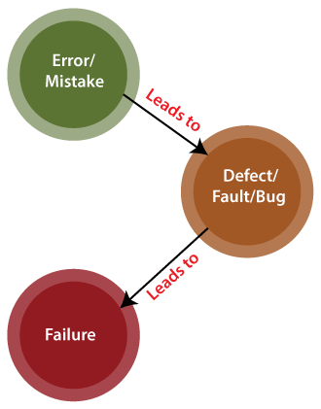
Dept of CSE

Slide 45
2) Test Case, Test Suite, and Test Harness
Test Case:
  A test case (often called a test) can be considered as comprising a set of test inputs and execution conditions, which are designed to exercise the software under test (SUT ) in a particular manner . Generally, a test case also specifies the expected outcome from executing the SUT under the specified execution conditions and test inputs.
  A test case answers the question: “What am I going to test?” You develop test cases to define the things that you must validate to ensure that the system is working correctly and is built with a high level of quality.
  Test Suite:
    A test suite is a collection of test cases that are grouped for test execution purposes.
Dept of CSE

Slide 46
Test Harness:
  Test Harness in Software Testing is a collection of stubs, drivers and other supporting tools required to automate test execution.
  A test harness is one of the popular testing processes that help testers to test each app’s features in detail, executing tests and generating a report for developers. So that developers can analyze the report and make changes per desired output. Typically, the test harness collects software, data, drivers, and other tools to test an application in different circumstances.
Dept of CSE

Slide 47
3) Psychology of Testing:
In software testing, psychology plays an extremely important role.
It is one of those factors that stays behind the scene, but has a great impact of the end result.
Categorized into three sections, the psychology of testing enables smooth testing as well as makes the process hassle free.
It is mainly dependent on the mindset of the developers and testers, as well as the quality of communication between them.
Moreover, the psychology of testing improves mutual understanding among team members and helps them work towards a common goal.
Dept of CSE

Slide 48
The three sections of the psychology of testing are:
  The mindset of Developers and Testers.
  Communication in a Constructive Manner.
  Test Independence.
  The mindset of Developers and Testers.
      Developers are responsible for creating or developing the system. Based on the requirements communicated by the business analyst.
      Testers, on the contrary, try to break the system using various means to identify any errors or bugs in the system that will stop the end user from using the system in the desired manner.
      Testers have a different mindset than developers, they analyze the developed system and look for any defects that deviate the system from the actual requirements communicated by the business analyst.
      it is important to understand that both the resources, developers, and testers have a different mentality and they work accordingly.
Dept of CSE

Slide 49
  Communication in a Constructive Manner.
  Testers find mistakes or errors in the system and communicate these findings with the developers.
  For a tester, finding the bugs is an accomplishment. But at the same time, for a developer, it is a mistake in his/her work and extra time will have to be spent on correcting the mistakes.
  Thus, it becomes necessary that the testers communicate the findings of the testing process in a polite and clear manner.
  Test Independence.
  The third and last factor is test independence. Finding mistakes in your own work is possible but not an effective idea.
  Developers, after building the product, test their code at the unit testing level. Developers can also perform integration testing and system testing.
Dept of CSE

Slide 50
But again, looking for bugs in your own features of the system may not be helpful and fruitful.
Thus, we need the help of an outsider who doesn’t work on the coding part.
Such people can be other developers, testers, clients, and end-users. Mostly, in an organization, a dedicated testing team is responsible for the testing process.
Test Independence Levels
Now, let’s talk about the test independence levels.
The first level of independence, where independence is very low. In level, test cases are designed by the developer who has worked on the feature(s) for which testing is to be done.
In the second level, independence is low. Here, test cases are designed by another developer who has not worked on the feature(s) for which testing is to be done.
Dept of CSE

Slide 51
In the third level, independence is medium. Here, test cases are designed by a dedicated testing team of the same organization.
In the fourth level, independence is high. Here, test cases are designed by a dedicated testing team of other organizations i.e. the testing process is outsourced.
Instead of developers, when a separate team is used to test the system, results will be superior.
Dept of CSE

Slide 52
4) Levels of Testing:
Software level testing can be majorly classified into 4 levels:
1. Unit Testing: A level of the software testing process where individual units/components of a software/system are tested. The purpose is to validate that each unit of the software performs as designed.
2. Integration Testing: A level of the software testing process where individual units are combined and tested as a group. The purpose of this level of testing is to expose faults in the interaction between integrated units.
3. System Testing: A level of the software testing process where a complete, integrated system/software is tested. The purpose of this test is to evaluate the system’s compliance with the specified requirements. In this level, the testing team tests the whole system.
4. Acceptance Testing: A level of the software testing process where a system is tested for acceptability. The purpose of this test is to evaluate the system’s compliance with the business requirements and assess whether it is acceptable for delivery. In this level, clients or their representatives and end-users test the system.
Dept of CSE

Slide 53
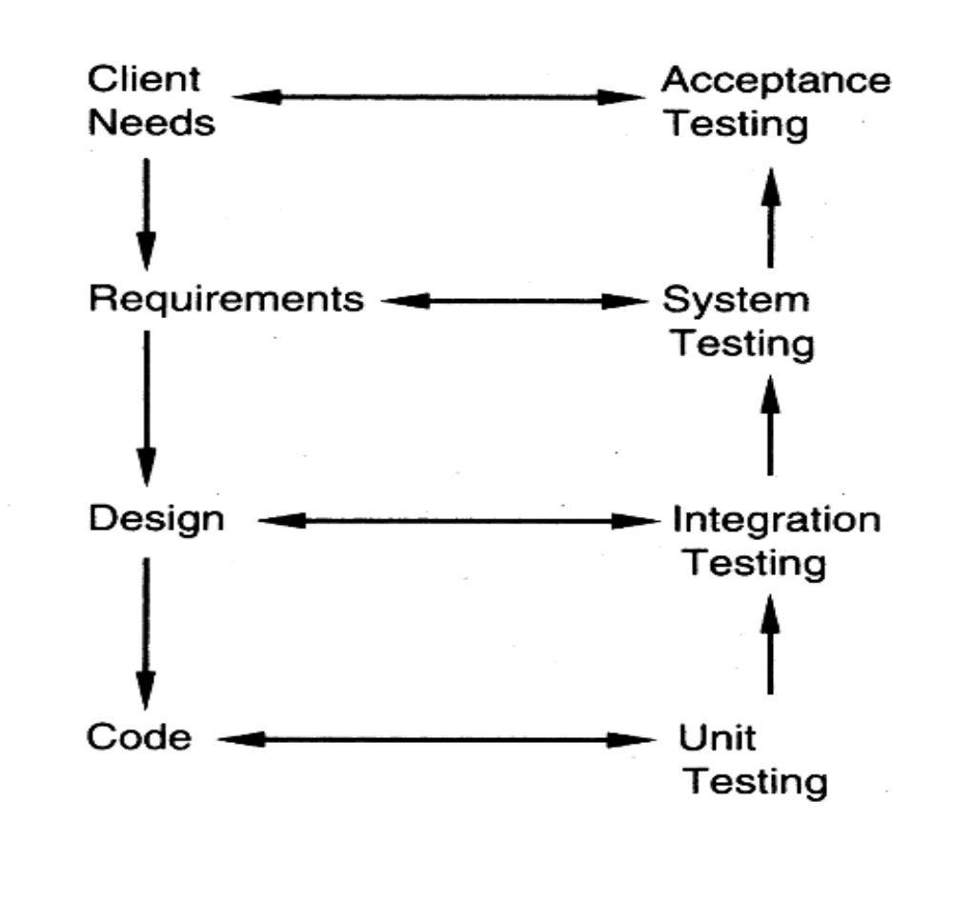
Dept of CSE

Slide 54
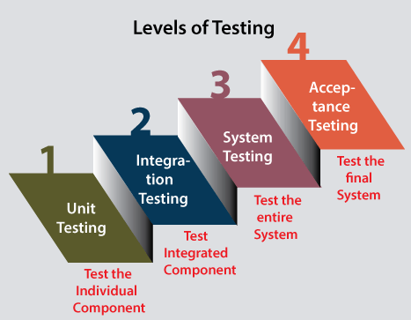
Dept of CSE

Slide 55
Testing Process:
The process of evaluating a system or its component(s) with the intent to find whether it satisfies the specified requirements or not.
The testing process for a project consists of three high-level tasks—test planning, test case design, and test execution.
Test Plan:
  A test plan is a general document for the entire project that defines the scope, approach to be taken, and the schedule of testing, as well as identifies the test items for testing.
  The test planning can be done well before the actual testing commences and can be done in parallel with the coding and design activities.
Dept of CSE

Slide 56
The inputs for forming the test plan are:
(1) project plan,
(2) requirements document, and
(3) architecture or design document.
The project plan is needed to make sure that the test plan is consistent with the overall quality plan for the project and the testing schedule matches that of the project plan.
The requirements document and the design document are the basic documents used for selecting the test units and deciding the approaches to be used during testing.
Dept of CSE

Slide 57
A test plan should contain the following:
– Test unit specification
Which test units should be tested are specified.
– Features to be tested
Features to be tested include all software features and combinations of features that should be tested.
– Approach for testing
approach for testing specifies the overall approach to be followed in the current project.
– Test deliverables
Testing deliverables should be specified in the test plan before the actual testing begins. Deliverables could be a list of test cases that were used, detailed results of testing including the list of defects found, test summary report, and data about the code coverage.
– Schedule and task allocation
The test plan typically also specifies the schedule and effort to be spent on different activities of testing, and the tools to be used.
Dept of CSE

Slide 58
2) Test Case Design:
The test plan focuses on how the testing for the project will proceed, which units will be tested, and what approaches (and tools) are to be used during the various stages of testing.
Test case design has to be done separately for each unit. Based on the approach specified in the test plan, and the features to be tested, the test cases are designed and specified for testing the unit.
Test case specification gives, for each unit to be tested, all test cases, inputs to be used in the test cases, conditions being tested by the test case, and outputs expected for those test cases.
Dept of CSE

Slide 59
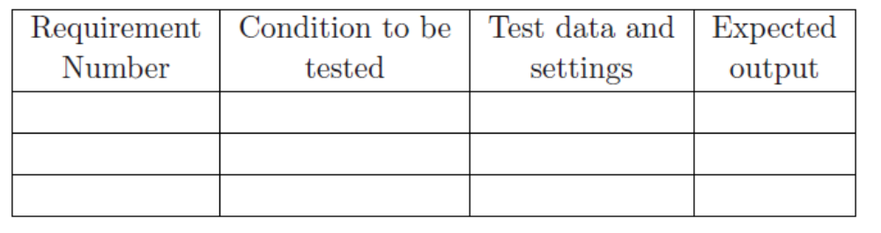
Test case specification table looks like
3) Test Case Execution:
With the specification of test cases, the next step in the testing process is to execute them.
The test case specifications only specify the set of test cases for the unit to be tested. However, executing the test cases may require construction of driver modules or stubs.
It may also require modules to set up the environment as stated in the test plan and test case specifications.
Dept of CSE

Slide 60
Only after all these are ready can the test cases be executed.
Defect logging and tracking:
During test case execution, defects are found. These defects are then fixed by developer and testing is done again to verify the fix.
A large software may have thousands of defects, found by many different people
Often person who fixes (usually the coder) is different from who finds
Due to large scope, reporting and fixing of defects cannot be done informally
Defects found are usually logged in a defect tracking system and then tracked to closure
Defect logging and tracking is one of the best practices in industry
Dept of CSE

Slide 61
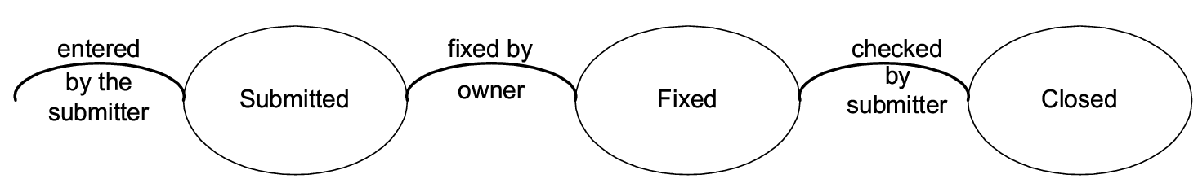
Defect logging…:
A defect in a software project has a life cycle of its own, like
  Found by someone, sometime and logged along with info about it (submitted)
  Job of fixing is assigned; person debugs and then fixes (fixed)
  The manager or the submitter verifies that the defect is indeed fixed (closed)
Dept of CSE

Slide 62
During the life cycle, info about defect is logged at diff stages to help debug as well as analysis
Defects generally categorized into a few types, and type of defects is recorded
  ODC is one classification
  Some std categories: Logic, standards, UI, interface, performance, documentation,..
Severity of defects in terms of its impact on sw is also recorded
Severity useful for prioritization of fixing
One categorization
  Critical: Show stopper
  Major: Has a large impact
  Minor: An isolated defect
  Cosmetic: No impact on functionality
Dept of CSE

Slide 63
Ideally, all defects should be closed
Sometimes, organizations release software with known defects (hopefully of lower severity only)
Organizations have standards for when a product may be released
Defect log may be used to track the trend of how defect arrival and fixing is happening
Dept of CSE

Slide 64
Black Box Testing:
Black Box Testing is a software testing method in which the functionalities of software applications are tested without having knowledge of internal code structure, implementation details and internal paths.
Black Box Testing mainly focuses on input and output of software applications and it is entirely based on software requirements and specifications. It is also known as Behavioral Testing.
In this method, tester selects a function and gives input value to examine its functionality, and checks whether the function is giving expected output or not. If the function produces correct output, then it is passed in testing, otherwise failed.
Dept of CSE

Slide 65
Techniques in Black Box Testing
Equivalence class partitioning: It is used to minimize the number of possible test cases to an optimum level while maintains reasonable test coverage.
  Equivalence class partitioning is a black-box testing technique or specification-based testing technique in which we group the input data into logical partitions called equivalence classes.
  It is a software testing technique that divides input domain into classes of data, and with the help of these classes of data, test cases can be derived.
  All the data items lying in an equivalence class are assumed to be processed in the same way by the software application to be tested when passed as input.
Dept of CSE

Slide 66
  Instead of testing all the combinations of input test data, we can pick and pass any of the test data from a particular equivalence class to the application and assume that the application will behave in the same way for the other test data of that class. Let’s understand this with the help of an example.
Guidelines for Equivalence Partitioning :
  If the range condition is given as an input, then one valid and two invalid equivalence classes are defined.
  If a specific value is given as input, then one valid and two invalid equivalence classes are defined.
  If a member of set is given as an input, then one valid and one invalid equivalence class is defined.
  If Boolean no. is given as an input condition, then one valid and one invalid equivalence class is defined.
Dept of CSE

Slide 67
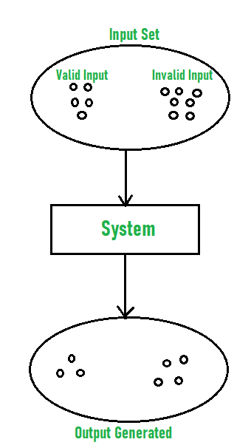
Dept of CSE

Slide 68
Let’s understand this with the help of an example.
Example-1:
Let us consider an example of any college admission process. There is a college that gives admissions to students based upon their percentage.
Consider percentage field that will accept percentage only between 50 to 90 %, more and even less than not be accepted, and application will redirect user to an error page. If percentage entered by user is less than 50 %or more than 90 %, that equivalence partitioning method will show an invalid percentage. If percentage entered is between 50 to 90 %, then equivalence partitioning method will show valid percentage.
Dept of CSE

Slide 69
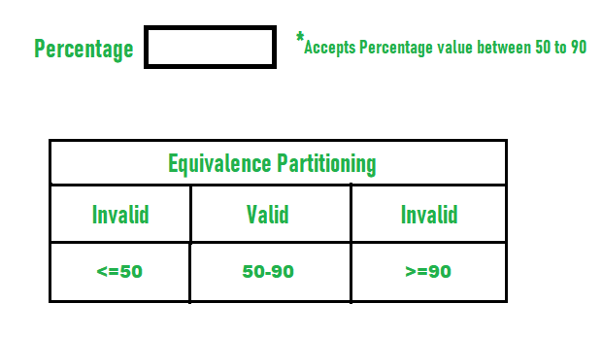
Dept of CSE

Slide 70
Example-2 :
Let us consider an example of software application. There is function of software application that accepts only particular number of digits, not even greater or less than that particular number.
Consider an OTP number that contains only 6 digit number, greater and even less than six digits will not be accepted, and the application will redirect customer or user to error page. If password entered by user is less or more than six characters, that equivalence partitioning method will show an invalid OTP. If password entered is exactly six characters, then equivalence partitioning method will show valid OTP.
Dept of CSE

Slide 71
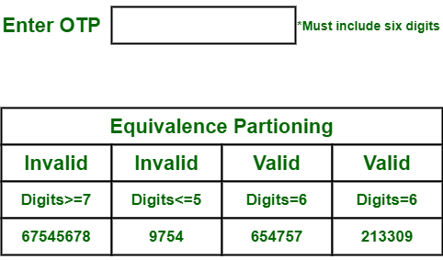
Dept of CSE

Slide 72
2) Boundary Value Analysis:
Boundary value analysis is a black-box testing technique. It is closely associated with equivalence class partitioning. In this technique, we analyze the behavior of the application with test data residing at the boundary values of the equivalence classes.
By using the test data residing at the boundaries, there is a higher chance of finding errors in the software application.
Example: Consider that you are filling an online application form for a gym membership. What are the most important criteria for getting a membership? Of course, the age! Most of the gyms have age criteria of 16-60, where you can independently get the membership without any supervision needed. If you look at below membership form, you will need to fill age first. After that, depending on whether you are between 16-60, you can go further. Otherwise, you will get a message that you cannot get a membership.
Dept of CSE

Slide 73
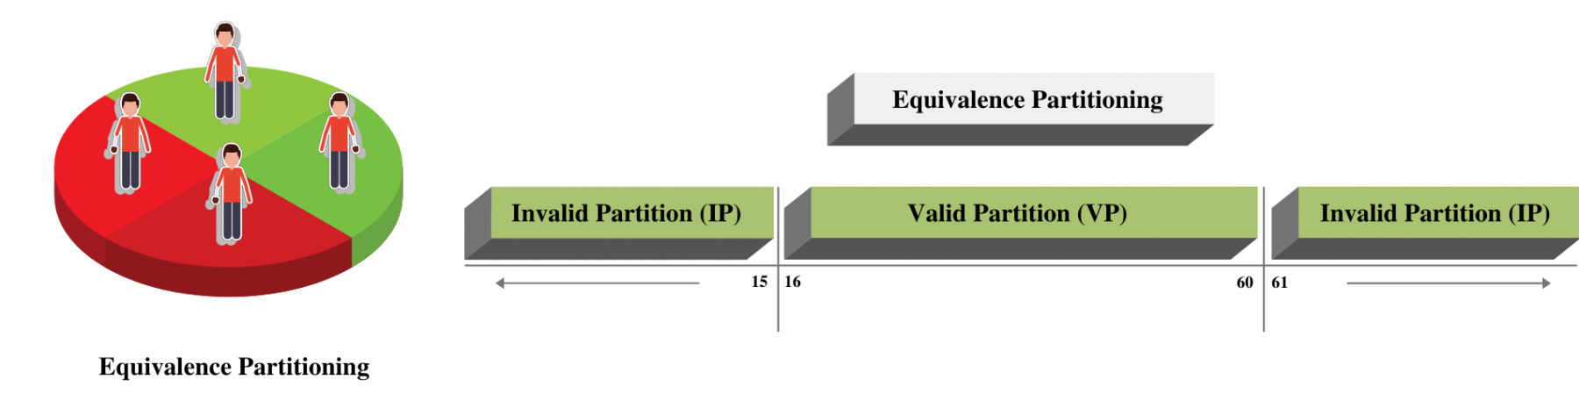
The first step of Boundary value analysis is to create Equivalence Partitioning, which would look like below.
Dept of CSE

Slide 74
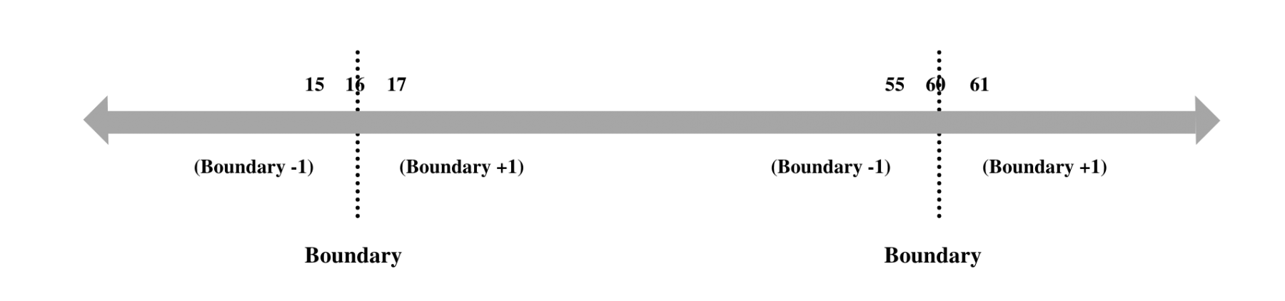
Now Concentrate on the Valid Partition, which ranges from 16-60. We have a 3 step approach to identify boundaries:
  Identify Exact Boundary Value of this partition Class - which is 16 and 60.
  Get the Boundary value which is one less than the exact Boundary - which is 15 and 59.
  Get the Boundary Value which is one more than the precise Boundary - which is 17 and 61 . If we combine them all, we will get below combinations for Boundary Value for the Age Criteria.
Dept of CSE

Slide 75
Valid Boundary Conditions : Age = 16, 17, 59, 60
Invalid Boundary Conditions : Age = 15 61,
The software system will be passed the test if it accepts a valid number and gives the desired output, if it is not, then it is unsuccessful. In another scenario, the software system should not accept invalid numbers, and if the entered number which is invalid, then it should display error message.
Dept of CSE

Slide 76
White Box Testing:
White Box Testing is a testing technique in which software’s internal structure, design, and coding are tested to verify input-output flow and improve design, usability, and security.
In white box testing, code is visible to testers, so it is also called Clear box testing, Open box testing, Transparent box testing, Code-based testing, and Glass box testing.
This testing is also known as structural or development testing.
In white-box testing, structure means the logic of the program which has been implemented in the language code.
The intention is to test this logic so that required results or functionalities can be achieved.
Dept of CSE

Slide 77
Is white-box testing really necessary? Can’t we write the code and simply test the software using black-box testing techniques?
The supporting reasons for white-box testing are given below:
  In fact, white-box testing techniques are used for testing the module for initial stage testing. Black-box testing is the second stage for testing the software.
  Though test cases for black box can be designed earlier than white-box test cases, they cannot be executed until the code is produced and checked using white-box testing techniques. Thus, white-box testing is an essential stage.
  Errors which have come from the design phase will also be reflected in the code, therefore we must execute white-box test cases for verification of code (unit verification).
Dept of CSE

Slide 78
  There are categories of bugs which can be revealed by white-box testing, but not through black-box testing. There may be portions in the code which are not checked when executing functional test cases, but these will be executed and tested by white-box testing.
  Some typographical errors are not observed and go undetected and are not covered by black-box testing techniques. White-box testing techniques help detect these errors.
Dept of CSE

Slide 79
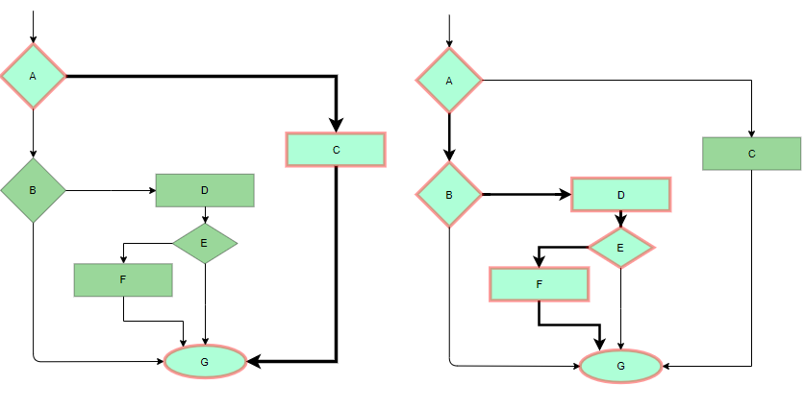
White Box Testing techniques:
1) Statement coverage: In this technique, the aim is to traverse all statement at least once. Hence, each line of code is tested. In case of a flowchart, every node must be traversed at least once. Since all lines of code are covered, helps in pointing out faulty code.
Dept of CSE

Slide 80
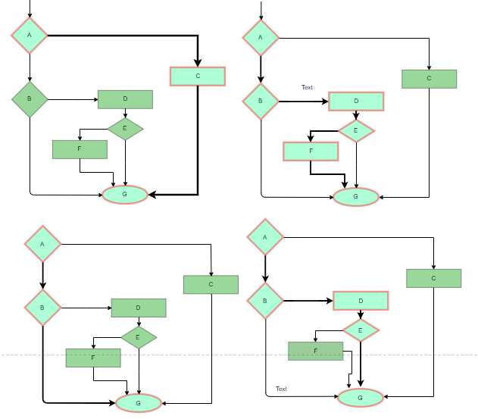
2) Branch Coverage: In this technique, test cases are designed so that each branch from all decision points are traversed at least once. In a flowchart, all edges must be traversed at least once.
Dept of CSE

Slide 81
3) Basis Path Testing: In this technique, control flow graphs are made from code or flowchart and then Cyclomatic complexity is calculated which defines the number of independent paths so that the minimal number of test cases can be designed for each independent path.
To learn Basis path testing we need to learn some concepts
a) Control Flow Graph:
  Control flow graph is a graphical representation of control structure of a program.
  Flow graphs can be prepared as a directed graph.
  A directed graph (V, E) consists of a set of vertices V and a set of edges E that are ordered pairs of elements of V.
  Each structured construct has a corresponding flow graph symbol.
Dept of CSE

Slide 82
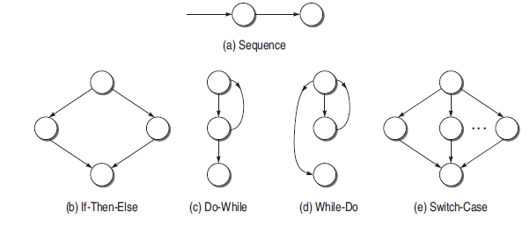
Dept of CSE

Slide 83
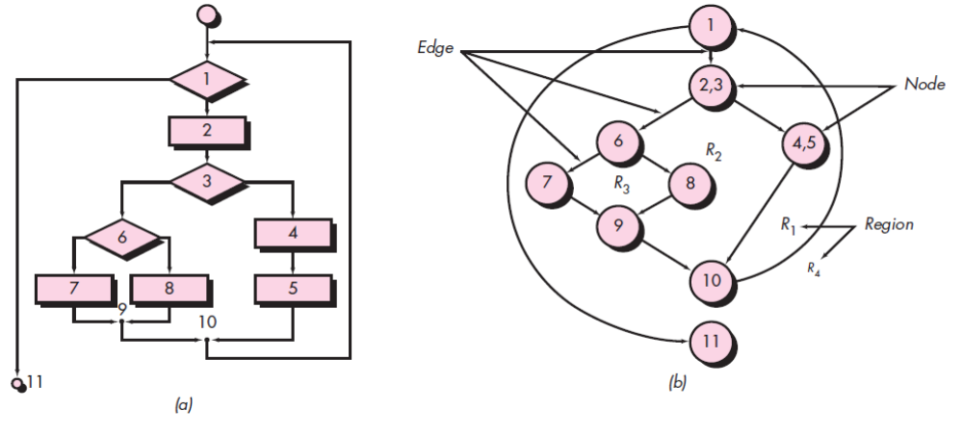
To illustrate the use of a flow graph, consider the procedural design representation in Figure (a) which is a flow chart of a program. Figure (b) maps the flowchart into a corresponding flow graph. Referring to (b) , each circle, called a flow graph node, represents one or more procedural statements. The arrows on the flow graph, called edges or links, represent flow of control and are analogous to flowchart arrows. Each node that contains a condition is called a predicate node
Dept of CSE

Slide 84
b) Independent Program Paths:
  An independent path is any path through the program that introduces at least one new set of processing statements or a new condition.
  When stated in terms of a flow graph, an independent path must move along at least one edge that has not been traversed before the path is defined.
  For example, a set of independent paths for the flow graph illustrated in Figure (b) is
Path 1: 1-11
Path 2: 1-2-3-4-5-10-1-11
Path 3: 1-2-3-6-8-9-10-1-11
Path 4: 1-2-3-6-7-9-10-1-11
  Note that each new path introduces a new edge. The
  path 1-2-3-4-5-10-1-2-3-6-8-9-10-1-11 is not considered to be an independent path because it is simply a combination of already specified paths and does not traverse any new edges.
Dept of CSE

Slide 85
c) Cyclomatic complexity: cyclomatic complexity defines the number of independent paths in the basis set of a program and provides you with an upper bound for the number of tests that must be conducted to ensure that all statements have been executed at least once.
Complexity is computed in one of three ways:
1. The number of regions of the flow graph is the cyclomatic complexity.
2. Cyclomatic complexity V(G) for a flow graph G is defined as V(G)= E -N +2
  where E is the number of flow graph edges and N is the number of flow graph nodes.
3. Cyclomatic complexity V(G) for a flow graph G is also defined as V(G) =P +1
  where P is the number of predicate nodes contained in the flow graph G.
Dept of CSE

Slide 86
Referring once more to the flow graph in Figure 18.2b, the cyclomatic complexity can be computed using each of the algorithms just noted:
1. The flow graph has four regions.
2. V(G) = 11 edges - 9 nodes + 2 =4.
3. V(G) =3 predicate nodes +1 =4.
Based on the above concepts Basis Path Testing can be done using following steps
Steps:
Make the corresponding control flow graph
Calculate the cyclomatic complexity
Find the independent paths
Design test cases corresponding to each independent path
Dept of CSE

Slide 87
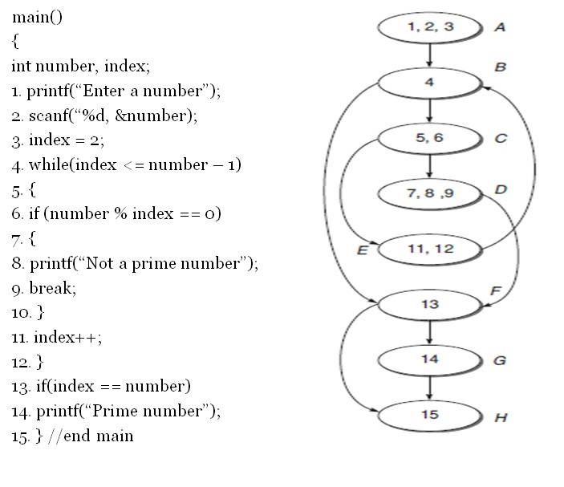
Example: consider a prime number program .
1) Draw a flow graph
Dept of CSE

Slide 88
2) Calculate Cyclomatic Complexity:
(i) V(G) = e – n + 2
= 10 – 8 + 2
= 4
(ii) V(G ) = Number of predicate nodes + 1
= 3 (Nodes B, C, and F ) + 1
= 4
(iii) V (G ) = Number of regions
= 4(R1, R2, R3, R4)
Dept of CSE

Slide 89
3) Find independent paths:
Since the cyclomatic complexity of the graph is 4, there will be 4 independent paths in the graph as shown below:
(i) A-B-F-H
(ii) A-B-F-G-H
(iii) A-B-C-E-B-F-G-H
(iv) A-B-C-D-F-H
Dept of CSE

Slide 90
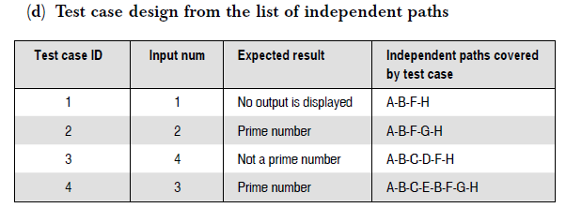
4) Design test case based on independent paths
Dept of CSE

Slide 91
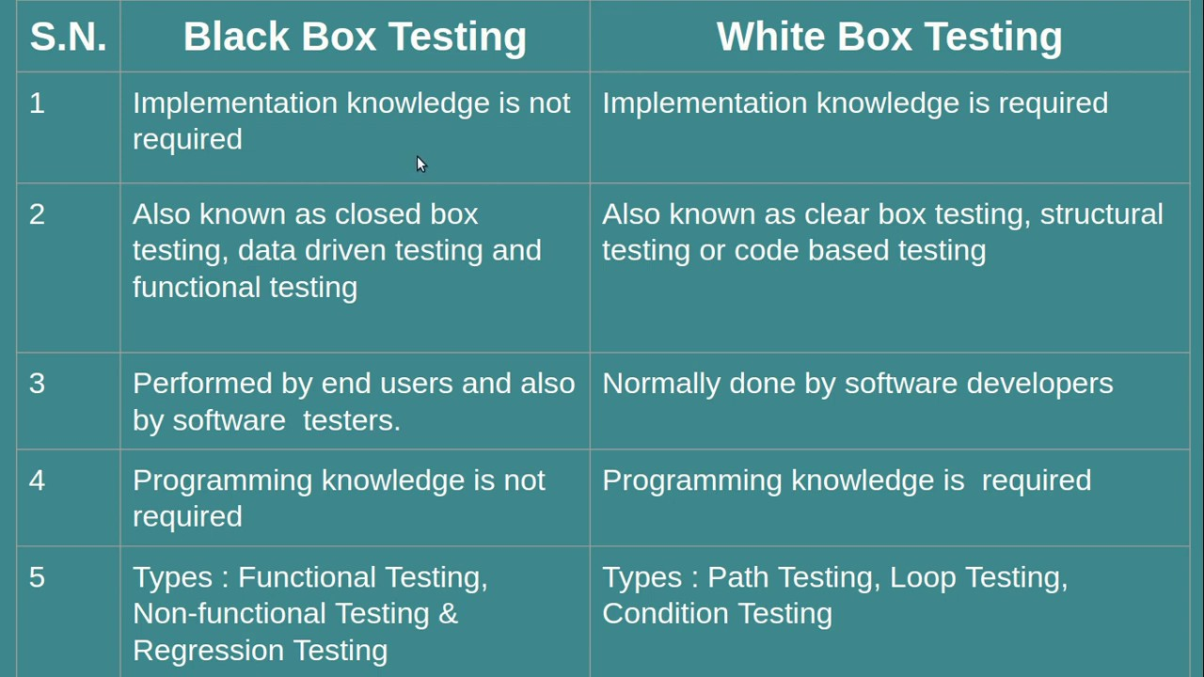

Slide 92
Part-3
Risk management
Dept of CSE

Slide 93
Reactive vs Proactive Risk strategies:
Reactive Risk Strategies:
Reactive risk management tries to reduce the damage of potential threats and speed an organization’s recovery from them, but assumes that those threats will happen eventually.
Reactive risk management is often compared to a firefighting scenario.
Reactive risk management kicks in when an accident occurs or concerns are discovered following an audit.
The accident is investigated, and measures are taken to avoid similar events happening in the future.
Further, measures will be taken to reduce the negative impact the incident could cause on business profitability and sustainability.
Dept of CSE

Slide 94
Proactive Risk Strategies:
Proactive risk management identifies threats and aims to prevent those events from ever happening in the first place.
In contrast to reactive risk management, proactive risk management aims to identify all relevant risks before an incident happens.
The current organisation must deal with an age of fast environmental change brought on by technological advancements, deregulation, intense competition, and raising public awareness.
As a result, risk management based on previous accidents is not a suitable decision for any company.
As a result, new risk management thinking was required, paving the way for proactive risk management.
So in this chapter we are discussing proactive risks
Dept of CSE

Slide 95
Software Risks:
"Tomorrow problems are today's risk." Hence, a clear definition of a "risk" is a problem that could cause some loss or threaten the progress of the project, but which has not happened yet.
Risk always involves two characteristics:
  uncertainty—the risk may or may not happen; that is, there are no 100 percent probable risks.
  loss—if the risk becomes a reality, unwanted consequences or losses will occur.
When risks are analyzed, it is important to quantify the level of uncertainty and the degree of loss associated with each risk. To accomplish this, different categories of risks are considered.
Dept of CSE

Slide 96
Categories of risks
Project risks:
  Project risks threaten the project plan. That is, if project risks become real, it is likely that the project schedule will slip and that costs will increase.
  Project risks are potential budgetary, schedule, personnel (staffing and organization), resource, stakeholder, and requirements problems which impact on a software project.
  Causes for project risks are:
    Wrong time estimation.
    Resources are not tracked properly. All resources like staff, systems, skills of individuals, etc.
    Less number of skilled people.
    Insufficient training
    Failure to identify complex functionalities and time required to develop those functionalities.
    Wrong budget estimation.
    Cost overruns
    Project scope expansion
Dept of CSE

Slide 97
Technical Risks:
  Technical risks threaten the quality and timeliness of the software to be produced.
  If a technical risk becomes a reality, implementation may become difficult or impossible.
  Technical risks identify potential design, implementation, interface, verification, and maintenance problems.
  Technical risks occur because the problem is harder to solve than you thought it would be.
  Causes of Technical Risks are:
    Continuously changing requirements
    No advanced technology is available or the existing technology is in the initial stages.
    The product is complex to implement.
    Difficult project module integration.
Dept of CSE

Slide 98
Business risks:
  Business risks threaten the viability of the software to be built and often put the project or the product into difficulties.
  Causes of Business Risks are:
    Building an excellent product or system that no one really wants (market risk).
    Building a product that no longer fits into the overall business strategy for the company (strategic risk).
    building a product that the sales force doesn’t understand how to sell (sales risk).
    losing the support of senior management due to a change in focus or a change in people (management risk)
    losing budgetary or personnel commitment (budget risks)
Dept of CSE

Slide 99
Other risk categories
Known risks are those that can be uncovered after careful evaluation of the project plan, the business and technical environment in which the project is being developed, and other reliable information sources (e.g., unrealistic delivery date, lack of documented requirements or software scope, poor development environment).
Predictable risks are extrapolated from past project experience (e.g., staff turnover, poor communication with the customer, dilution of staff effort as ongoing maintenance requests are serviced).
Unpredictable risks are the joker in the deck. They can and do occur, but they are extremely difficult to identify in advance.
Dept of CSE

Slide 100
Risk Identification:
Identifying risk is one of most important or essential and initial steps in risk management process.
By identifying known and predictable risks, the project manager takes a first step toward avoiding them when possible and controlling them when necessary.
Methods for Identifying Risks : Earlier, there were no easy methods available that will surely identify all risks. But nowadays, there are some additional approaches available for identifying risks. Some of approaches for risk identification are given below:
1. Checklist Analysis: Checklist Analysis is type of technique generally used to identify risks. The checklist is basically developed by listing items as per the following categories-
Dept of CSE

Slide 101
  Product size—risks associated with the overall size of the software to be built or modified.
  Business impact—risks associated with constraints imposed by management or the marketplace.
  Stakeholder characteristics—risks associated with the sophistication of the stakeholders and the developer’s ability to communicate with stakeholders in a timely manner.
  Process definition—risks associated with the degree to which the software process has been defined and is followed by the development organization.
  Development environment—risks associated with the availability and quality of the tools to be used to build the product.
  Technology to be built—risks associated with the complexity of the system to be built and the “newness” of the technology that is packaged by the system.
  Staff size and experience—risks associated with the overall technical and project experience of the software engineers who will do the work.
Dept of CSE

Slide 102
The risk item checklist can be organized in different ways. Questions relevant to each of the topics can be answered for each software project.
The answers to these questions allow you to estimate the impact of risk.
2) SWOT Analysis – Strengths-Weaknesses-Opportunities-Threat (SWOT) is very helpful technique in identifying risks within greater organization context. It is generally used as planning tool for analyzing business, its resources, and also its environment simply by looking at internal strengths and weaknesses and opportunities and threats in external environment. It is technique often used in formulation of strategy. The appropriate time and effort should be spent on thinking seriously about weaknesses and threats of organization for SWOT analysis to more effective and successful in risk identification.
Dept of CSE

Slide 103
3) Flowchart Method – This method allows for dynamic process to be diagrammatically represented in paper. This method is generally used to represent activities of process graphically and sequentially to simply identify the risk.
Dept of CSE

Slide 104
Risk Projection:
Risk projection, also called risk estimation, attempts to rate each risk in two ways—
(1) the probability that the risk is real or true and
(2) the consequences of the problems associated with the risk, if any.
The project planner, along with other managers and technical staff, performs four risk projection activities:
  (1) Make a scale that shows how serious you think a risk is.
  (2) Define the consequences of the risk.
  (3) Estimate the impact of the risk on the project and the product.
  (4) Note the overall accuracy of the risk projection to prevent misunderstandings.
Dept of CSE

Slide 105
The intent of these steps is to consider risks in a manner that leads to prioritization.
No software team has the resources to deal with all possible risks to the same extent.
By prioritizing risks, you can allocate resources where they will have the most impact.
Developing a Risk Table:
Developing a Risk table provides a project manager with a simple technique for risk projection.
Steps in Setting up Risk Table
  (1) Project team begins by listing all risks in the first column of the table. Accomplished with the help of the risk item checklists.
  (2) Each risk is categorized in the second column. (e.g. PS implies a project size risk, BU implies a business risk).
Dept of CSE

Slide 106
  (3) The probability of occurrence of each risk is entered in the next column of the table. The probability value for each risk can be estimated by team members individually. Individual team members are polled in round-robin fashion until their assessment of risk probability begins to converge.
  (4) the impact of each risk is assessed by considering the four risk components—performance, support, cost, and schedule—are averaged3 to determine an overall impact value
Once the first four columns of the risk table have been completed, the table is sorted by probability and by impact. High-probability, high-impact risks percolate to the top of the table, and low-probability risks drop to the bottom. This accomplishes first-order risk prioritization.
All the risks which had occurred should be managed with the help of RMMM plan.
Dept of CSE

Slide 107
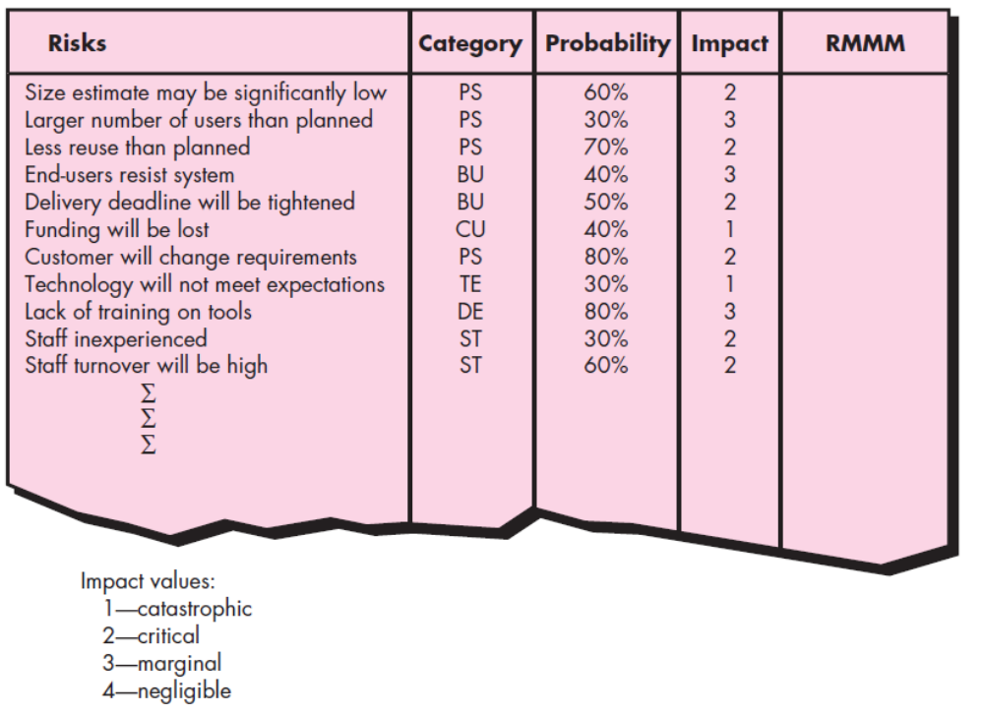
Dept of CSE

Slide 108
Assessing Risk Impact:
Risk impact assessment is the process of assessing the probabilities and consequences of risk events if they occur.
Three factors affect the consequences that are likely if a risk does occur are :
its nature: The nature of the risk indicates the problems that are likely if it occurs.
Ex: a poorly defined external interface to customer hardware (a technical risk) will preclude early design and testing and will likely lead to system integration problems late in a project.
its scope: The scope of a risk tells the severity (just how serious is it?) with its overall distribution (how much of the project will be affected or how many stakeholders are harmed?).
Dept of CSE

Slide 109
its timing: the timing of a risk considers when and for how long the impact will take to occur.
  In most cases, you want the “bad news” to occur as soon as possible, but in some cases, the longer the delay, the better.
The overall risk exposure RE is determined using the following relationship
RE =P * C
where P is the probability of occurrence for a risk, and C is the cost to the project should the risk occur.
Dept of CSE

Slide 110
For example, assume that the software team defines a project risk in the following manner:
Risk identification. Only 70 percent of the software components scheduled for reuse will, in fact, be integrated into the application. The remaining functionality will have to be custom developed.
Risk probability. 80 percent (likely).
Risk impact. Sixty reusable software components were planned. If only 70 percent can be used, 18 components would have to be developed from scratch . Since the average component is 100 LOC and local data indicate that the software engineering cost for each LOC is $14.00, the overall cost (impact) to develop the components would be 18 * 100*14 =$25,200.
Risk exposure. RE =0.80 *25,200 =$20,200.
Risk exposure can be computed for each risk in the risk table, once an estimate of the cost of the risk is made. The total risk exposure for all risks can provide a means for adjusting the final cost estimate for a project.
Dept of CSE

Slide 111
Risk Refinement:
During early stages of project planning, a risk may be stated quite generally.
As time passes and more is learned about the project and the risk, it may be possible to refine the risk into a set of more detailed risks, each somewhat easier to mitigate, monitor, and manage.
One way to do this is to represent the risk in condition-transition-consequence (CTC) format .
That is, the risk is stated in the following form:
Given that <condition> then there is concern that (possibly) <consequence>.
Dept of CSE

Slide 112
Using the CTC format for the reuse risk noted in above you could write:
  Given that all reusable software components must conform to specific design standards and that some do not conform, then there is concern that (possibly) only 70 percent of the planned reusable modules may actually be integrated into the as-built system, resulting in the need to custom engineer the remaining 30 percent of components.
This general condition can be refined in the following manner:
  Subcondition 1. Certain reusable components were developed by a third party with no knowledge of internal design standards.
  Subcondition 2. The design standard for component interfaces has not been solidified and may not conform to certain existing reusable components.
  Subcondition 3. Certain reusable components have been implemented in a language that is not supported on the target environment.
Dept of CSE

Slide 113
Risk Mitigation, Monitoring, and Management (RMMM) plan:
To assist the project team in developing a strategy for dealing with risk.
An effective strategy must consider three issues:
  risk avoidance, risk monitoring, and risk management
Risk Mitigation : It is an activity used to avoid problems (Risk Avoidance).
Steps for mitigating the risks as follows.
  Finding out the risk.
  Removing causes that are the reason for risk creation.
  Controlling the corresponding documents from time to time.
  Conducting timely reviews to speed up the work.
Dept of CSE

Slide 114
Risk Monitoring : Risk monitoring is an activity used to track a project's progress.
It has the following primary objectives as follows.
  To check if predicted risks occur or not.
  To ensure proper application of risk aversion steps defined for risk.
  To collect data for future risk analysis.
  To allocate what problems are caused by which risks throughout the project.
  Risk Management: It assumes that the mitigation activity failed and the risk is a reality. When a risk becomes a reality and produces serious problems, the project manager is in charge of this responsibility. It is easier to manage risks if the project manager successfully implements project mitigation to eliminate risks. This demonstrates how a manager will respond to each risk. The risk register is the key objective of the risk management plan. This risk register identifies and prioritizes potential dangers to a software project.
Dept of CSE

Slide 115
In this technique risk is monitored continuously by reevaluating the risks, the impact of risk and probability of occurrence of risk.
This ensures that:
Risk have been reduced
New risk are discovered
Impact and magnitude of risk are measured
Dept of CSE

Slide 116
RMMM Plan:
The RMMM PLAN documents all work performed as part of risk analysis and used by the project manager as part of the overall project plan.
Each risk is documented individually using a risk information sheet.
The format of the RIS is illustrated in Figure
Dept of CSE

Slide 117
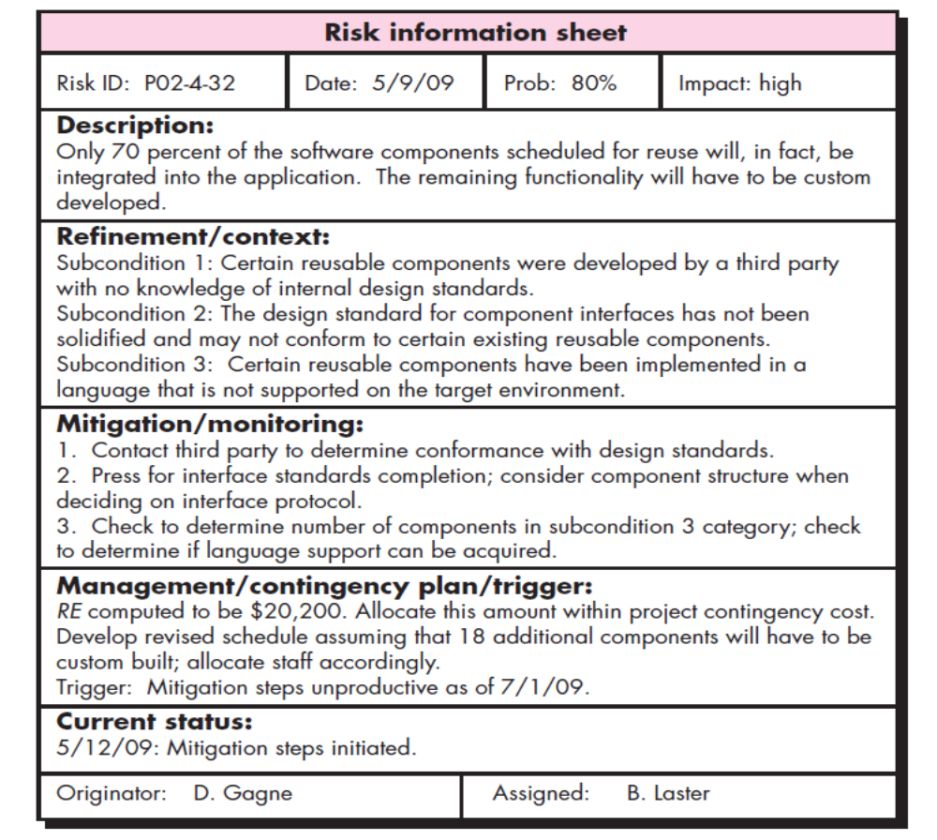
Dept of CSE

Slide 118
Once RMMM has been documented and the project has begun, risk mitigation and monitoring steps commence.
risk mitigation is a problem avoidance activity.
Risk monitoring is a project tracking activity with three primary objectives:
  (1) to assess whether predicted risks do, in fact, occur;
  (2) to ensure that risk aversion steps defined for the risk are being properly applied; and
  (3) to collect information that can be used for future risk analysis.
In many cases, the problems that occur during a project can be traced to more than one risk. Another job of risk monitoring is to attempt to allocate origin.
Dept of CSE

Slide 119
Drawbacks of RMMM:
It incurs additional project costs.
It takes additional time.
For larger projects, implementing an RMMM may itself turn out to be another tedious project.
RMMM does not guarantee a risk-free project, infact, risks may also come up after the project is delivered.
A larger project's implementation of an RMMM could prove to be a time-consuming process in and of itself.
RMMM cannot guarantee a project will be risk-free; in fact, hazards could materialise after the project has been delivered.
Not All Organisations Should Use RMMM.
Data security is an issue for RMMM.
Focus Loss from Automation

